Slide 1
The Hubble Olympics:
Regression of eight friedmann models
IVC ASML 2021 - Group 5

Slide 2
Outline
The Competition (Background and Objectives)
The Competitors (Friedmann Models)
Methodology
Results

Slide 3
Background
-> Friedmann’s equation needs correction
Because: the observational data doesn’t match
Implies something else is there in the universe

Slide 4
Models
8 Models

Slide 5
We are comparing different friedmann equations

Slide 6
Ultranest
When scientific models are compared to data, two tasks are important:
1) constraining the model parameters
2) comparing the model to other models. Different techniques have been developed to explore model parameter spaces. This package implements a Monte Carlo technique called nested sampling.

Slide 7
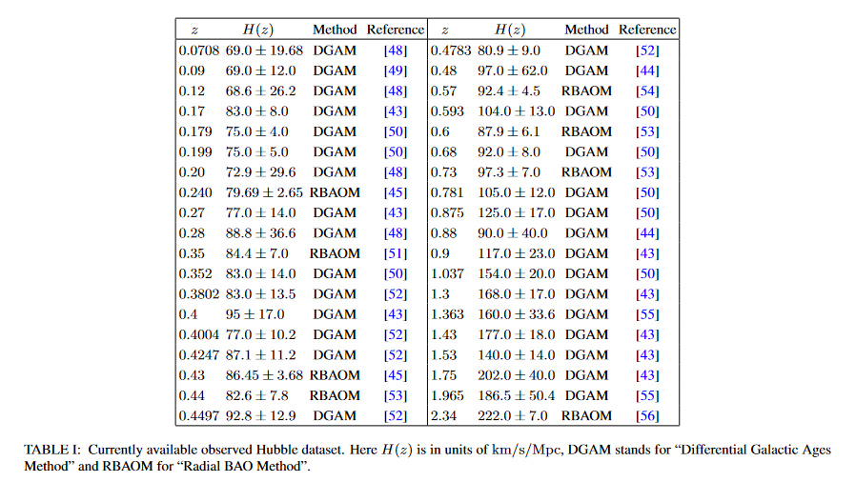
Hubble Dataset

Slide 8
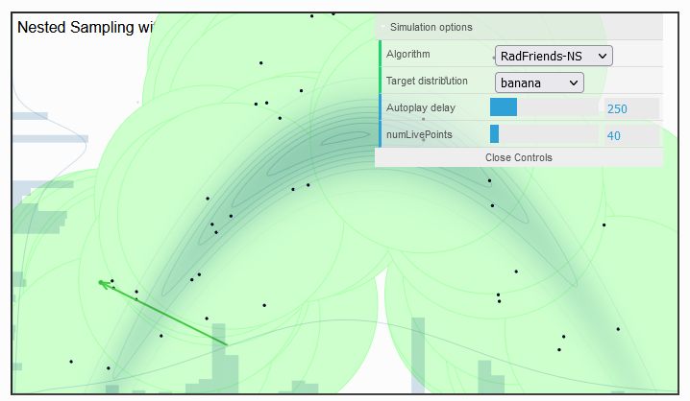
Nested Sampling

Slide 9
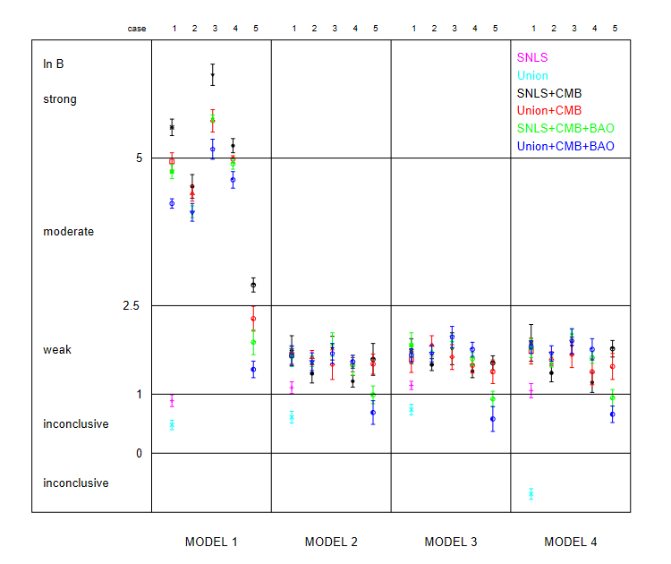
THe result

Slide 10
Model | Parameters | Ln Z | Ln B_12
LCDM | H0 = 74.02 {+13.89, -7.25} OM = 0.25 {+0.06, -0.07} OL = 0.75 {+0.17, -0.22} | -47.079 +- 0.206 | N/A (Used as the standard)
Domain Walls | H0 = 74.33 {+14.30, -7.19} OM = 0.21 {+0.05, -0.06} OD = 0.76 {+0.17, -0.22} | -46.402 +- 0.175 | -0.677 +- 0.381 (Inconclusive)
Cosmic strings | H0 = 74.96 {+14.15, -7.50} OM = 0.21 {+0.05, -0.06} OS = 0.75 {+0.17, -0.22} | -46.429 +- 0.386 | -0.65 +- 0.591 (Inconclusive)
Phantom energy | H0 = 74.50 {+14.18, -7.18} OM = 0.25 {+0.07, -0.07} OP = 0.73 {+0.18, -0.21} W_p = -1.03 (+0.01, -0.03) | -51.199 +- 0.244 | 4.12 +- 0.45 (Moderate preference for LCDM)
Mod grav 1 (inverse monomial) | H0 = 72.92 {+0.30, -0.28} B = 1.97 {+0.08, -0.07} | -62.531 +- 0.179 | 15.452 +- 0.385 (Strong preference for LCDM)
mod grav 2 (exponential) | H0 = 73.31 {+0.26, -0.25} B = 2.12 {+0.05, -0.05} | -46.883 +- 0.168 | -0.196 +- 0.374 (Inconclusive)
Mod grav 3 (logarithmic) | H0 = 68.47 {+0.16,-0.15} B = 0.6834 {+0.01,-0.01} | -267.800+- 0.230 | 220.721 +- 0.436 (Strong preference for LCDM)
Backreaction | H0 = 72.28 {+0.21, -0.20} OM = 0.14 {+0.01, -0.01} | -58.5772+-0.187 | 11.4982 +- 0.393 (Strong preference for LCDM)

